Slide 1



Artificial Intelligence Chapter 21 The Situation Calculus (状态演算)

Slide 2
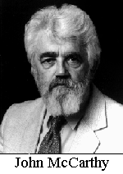
--美国数学家、计算机
科学家，人工智能的
早期研究者。
--首次提出“Artificial
Intelligence”一词

Slide 3



21.1 Reasoning about States and Actions (50 minutes)
21.2Some Difficulties (50 minutes)
--frame problem(框架问题)
--qualification problem(条件问题)
--ramification problem(分枝问题)
21.3 Generating Plans (50 minutes)
Additional Readings and Discussion
Outline

Slide 4
21.1 Reasoning about States and Actions
To investigate feature-based planning methods much more thoroughly, richer language to describe features and the constraints among them will be introduced.
Generally, a goal condition can be described by any wff in the predicate calculus, and we can determine if a goal is satisfied in a world state described by formulas by attempting to prove the goal wff from those formulas.

Slide 5
Situation calculus (1/3)
Definition: A predicate calculus formalization of states, actions, and the effects of actions on states.
Our knowledge about states and actions as formulas in the first-order predicate calculus
Then use a deduction system to ask questions such as “Does there exist a state to satisfy certain properties, and if so, how can the present state be transformed into that state by actions”
⇒ A plan for achieving the desired state.

Slide 6
Situation calculus (2/3)
The situation calculus was used in some early AI planning systems. ⇒ it does not used nowadays.
However, the formalism remains important for exposing and helping to clarify conceptual problems.

Slide 7
Situation calculus (3/3)
In order to describe states in the situation calculus, we reify states.
States can be denoted by constant symbols (S0, S1, S2, …), by variables, or by functional expressions.
Fluents: the atomic wff can denote relations over states.

Slide 8
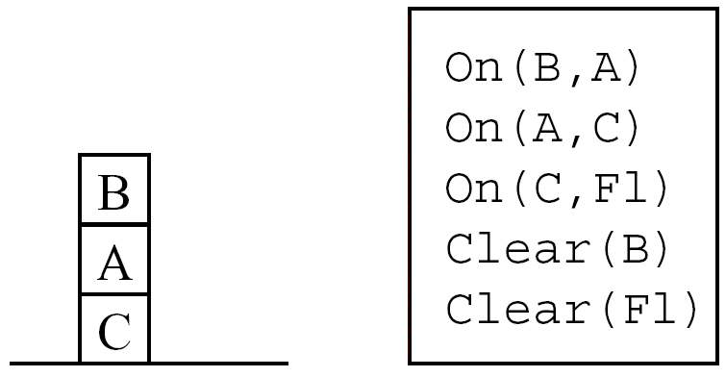
Example (Figure 21.1)

Slide 9
First-order predicate calculus
On(B,A)∧On(A,C)∧On(C,F1)∧Clear(B)∧…
True statement
On(B,A,S0)∧On(A,C,S0)∧On(C,F1,S0)∧Clear(B, S0)
Prepositions true of all states
(∀x,y,s)[On(x,y,s)∧¬(y=F1)⊃ ¬Clear(y,s)]
And (∀s)Clear(F1,s)

Slide 10
To represent actions and the effects (1/2)
Reify the action
Actions can be denoted by constant symbols, by variables, or by functional expressions
Generally, we can represent a family of move actions by the schema, move(x,y,z), where x, y, and z are schema variables.
2.Imagine a function constant, do, that denotes a function that maps actions and states into states.
do(α,σ) denotes a function that maps the state-action pair into the state obtained by performing the action denoted by α in the state denoted by σ.

Slide 11
To represent actions and the effects (2/2)
Express the effects of actions by wffs.
There are two such wffs for each action-fluent pair.
For the pair {On, move}.
[On(x,y,s)∧Clear(x,s)∧Clear(z,s)∧(x≠z)
⊃On(x,z,do(move(x,y,z),s))]
And [On(x,y,s)∧Clear(x,s)∧Clear(z,s)∧(x≠z)
⊃ ¬On(x,z,do(move(x,y,z),s))]
preconditions
positive effect axiom
negative effect axiom
consequent
11

Slide 12
Effect axioms
We can also write effect axioms for the {Clear, move} pair.
[On(x,y,s)∧Clear(x,s)∧Clear(z,s)∧(x≠z)∧(y≠z)
⊃Clear(y,do(move(x,y,z),s))]
[On(x,y,s)∧Clear(x,s)∧Clear(z,s)∧(x≠z)∧(z≠F1)
⊃ ¬Clear(z,do(move(x,y,z),s))]
The antecedents consist of two parts
One part expresses the preconditions under which the action can be executed
The other part expresses the condition under which the action will have the effect expressed in the consequent of the axiom.

Slide 13
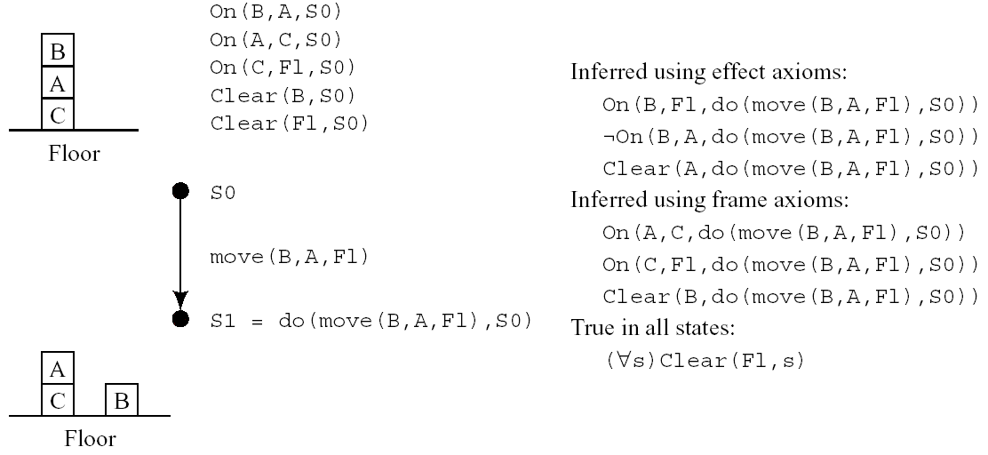
Figure 21.2 Mapping a State-Action Pair into a State
13

Slide 14
21.2.1 Frame Axioms (1/3)
Not all of the statements true about state do(move(B,A,F1),S0) can be inferred by the effects axioms.
Before the move, such as that C was on the floor and that B was clear are also true of the state after the move.
In order to make inferences about these constancies, we need frame axioms for each action and for each fluent that doesn’t change as a result of the action.

Slide 15
21.2.1 Frame Axioms (2/3)
The frame axioms for the pair, {(move, On)}
[On(x,y,s)∧(x≠u)] ⊃ On(x,y,do(move(u,y,z),s))
[(¬On(x,y,s)∧[(x≠u)∨(y≠z)] ⊃ ¬On(x,y,do(move(u,v,z),s))
The frame axioms for the pair, {move, Clear}
Clear(u,s)∧(u≠z)] ⊃ Clear(u,do(move(x,y,z),s))
¬Clear(u,s)∧(u≠y) ⊃ ¬Clear(u,do(move(x,y,z),s))
positive frame axioms
negative frame axioms

Slide 16
21.2.1 Frame Axioms (3/3)
Frame axioms are used to prove that a property of a state remains true if the state is changed by an action that doesn’t affect that property.
Frame problem
The various difficulties associated with dealing with fluents that are not affected by actions.

Slide 17
21.2.2 Qualifications
The antecedent of the transition formula describing an action such as move gives the preconditions for a rather idealized case.
To be more precise, adding other qualification such as ¬Too_heavy(x,s), ¬Glued_down(x,s), ¬Armbroken(s), …
Qualification problem
The difficulty of specifying all of the important qualifications.

Slide 18
21.2.3 Ramifications
Ramification problem
Keeping track of which derived formulas survive subsequent state transitions.

Slide 19
21.3 Generating Plans
To generate a plan that achieves some goal, γ(s),
We attempt to prove (∃s) γ(s)
And use the answer predicate to extract the state as a function of the nested actions that produce it.

Slide 20
Example (Figure 21.1) (1/2)
We want a plan that gets block B on the floor from the initial state, S0, given in Figure 21.1.
Prove (∃s) On(B, F1, s)
We will prove by resolution refutation that the negation of (∃s) On(B, F1, s), together with the formulas that describe S0 and the effects of move are inconsistent.
Use an answer predicate to capture the substitutions made during the proof.

Slide 21
Example (Figure 21.1) (2/2)
On(A,C,S0)
On(C,F1,S0)
Clear(B,S0)
Clear(F1,S0)
[On(x,y,s)∧Clear(x,s) ∧Clear(z,s) ∧(x≠z)⊃ On(x,z,do(move(x,y,z),s))]

Slide 22
Difficulties
If several actions are required to achieve a goal, the action functions would be nested.
The proof effort is too large for even simple plan.

Slide 23
Additional Readings
[Reiter 1991]
Successor-state axiom
[Shanahan 1997]
Frame problem
[Levesque, et al. 1977]
GOLOG(alGol in LOGic)
[Scherl & Levesque 1993]
Robot study in Perception Robot Group

